Slide 1
Computational Drug Discovery using Masked Language Models
Mini Project – 2 (BTCOM607)
Prajwal Gurnule (2146491245011)
Renuka Kothekar (2146491245016)
Pranav Ikhar (2146491245009)
Ritika Bhonge (2146491245003)
Mr. Amol Jumde
Assistant Professor

Slide 2
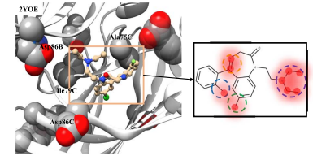
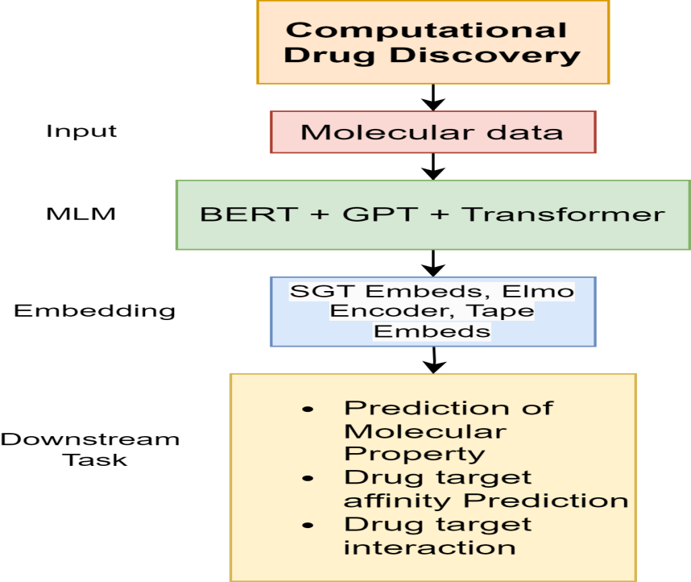
1. Introduction
In the past decade, the practice of drug discovery has been undergoing radical transformations in light of the advancements in artificial intelligence, which, at its core, is molecular representation learning.
In our drug discovery project, we divide tasks into two main categories: predicting potential drug candidates based on their molecular properties and predicting drugtarget binding affinity.
The first involves calculating molecular descriptors, engineering features, building predictive models, and identifying promising molecules. The second focuses on simulating interactions between drugs and targets using molecular docking and advanced machine learning models to predict binding affinities, followed by experimental validation and optimization. Combining these approaches streamlines the identification and evaluation of effective drug candidates, enhancing the efficiency of the drug discovery process.

Slide 3
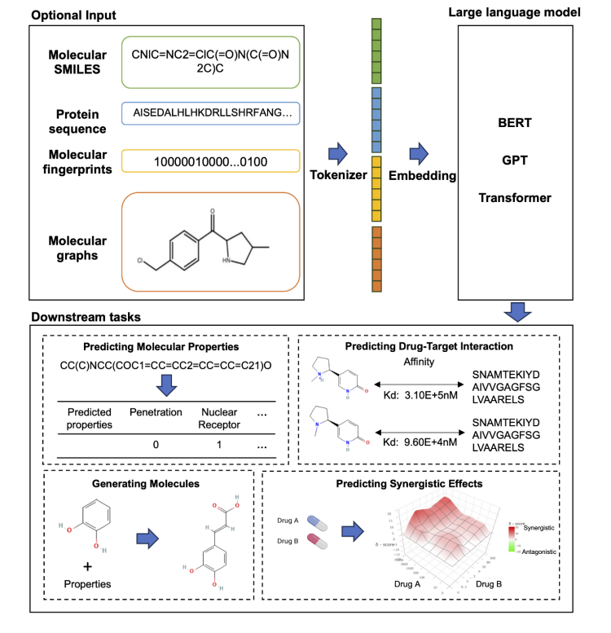
2. Objectives
The Primary objective is to –
Understanding the Drug discovery and Concept
Develop or integrate computational tools to calculate various molecular descriptors (e.g., molecular weight, hydrogen bond donors and acceptors).
Use predictive models to rank and shortlist top candidates for subsequent experimental validation.
Build and train advanced machine learning models (e.g., deep learning, graph-based neural networks) to predict binding affinities.
Select model validation as Mean-Squared error for the regression model also applying different forms of clustering .

Slide 4


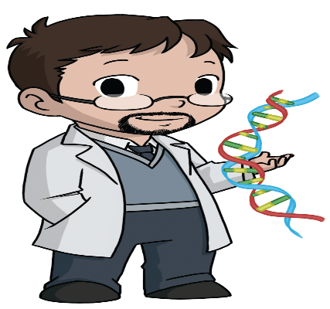
3. Stakeholders
Biomedical Researchers and Bioinformaticians
Students
Academic Institutions and Educators

Slide 5
4. Literature Survey.
Sr. No. | Paper Details | Work reported
1. | Liu, Jiajia, Mengyuan Yang, Yankai Yu, Haixia Xu, Kang Li, and Xiaobo Zhou. "Large language models in bioinformatics: applications and perspectives." arXiv preprint arXiv:2401.04155 (2024). | This article summarizes the potential and prospects of large language models in solving bioinformatic problems. It present a summary of the prominent large language models used in natural language processing, such as BERT and GPT
2. | Xia, Leiming, Lei Xu, Shourun Pan, Dongjiang Niu, Beiyi Zhang, and Zhen Li. "Drug-target binding affinity prediction using message passing neural network and self supervised learning." BMC genomics 24, no. 1 (2023): 557. | In this paper, a DTA prediction model using the deep learning method is proposed, which uses an undirected-CMPNN for molecular embedding and combines CPCProt and MLM models for protein embedding. An attention mechanism is introduced to discover the important part of the protein sequence. The proposed method is evaluated on the datasets Ki and Davis, and the model outperformed other deep learning methods.
3. | Qizhi Pei, Lijun Wu, Jinhua Zhu, Yingce Xia, Shufang Xie, Tao Qin, Haiguang Liu, Tie-Yan Liu, Rui Yan, Breaking the barriers of data scarcity in drug–target affinity prediction, Briefings in Bioinformatics, Volume 24, Issue 6, November 2023, bbad386, https://doi.org/10.1093/bib/bbad386 | In this article, evaluate SSM-DTA framework by conducting experiments on several benchmarks, including the BindindDB, DAVIS and KIBA. The results showed that SSM-DTA significantly improved the accuracy of DTA prediction,
4. | Jiang, M., Wang, S., Zhang, S. et al. Sequence-based drug-target affinity prediction using weighted graph neural networks. BMC Genomics 23, 449 (2022). https://doi.org/10.1186/s12864-022-08648-9 | In this Article,The proposed model which is called WGNN-DTA can be competent in drug-target affinity (DTA) and compound-protein interaction (CPI) prediction tasks. Various experiments are designed to verify the performance of the proposed method in different scenarios, which proves that WGNN-DTA has the advantages of simplicity and high accuracy.

Slide 6
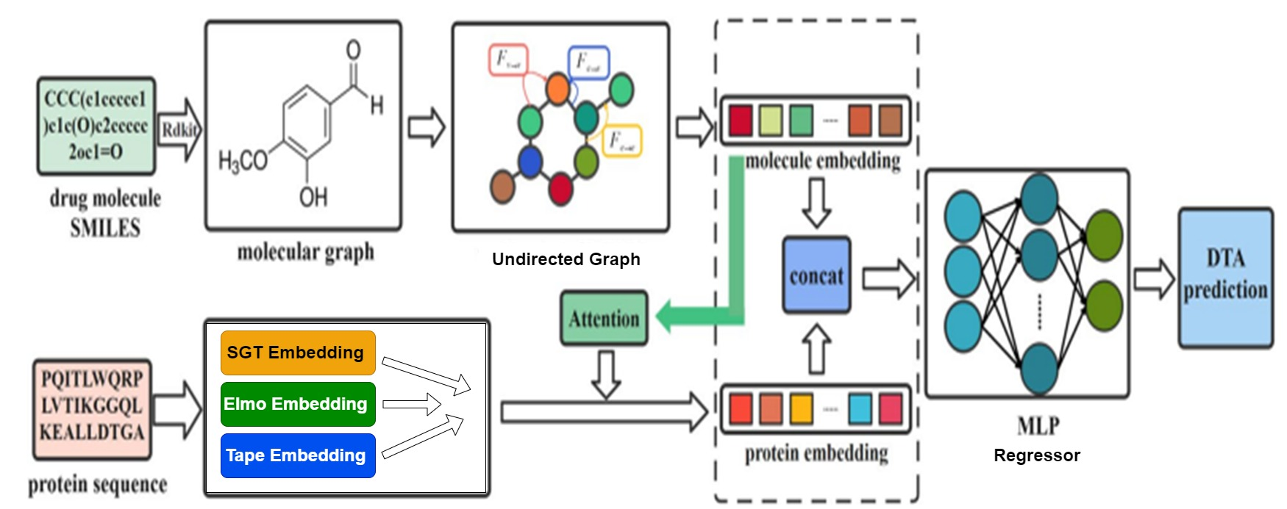
5. Proposed Solution
Drug target Affinity Prediction
Fig. 1 : The proposed system [6]

Slide 7
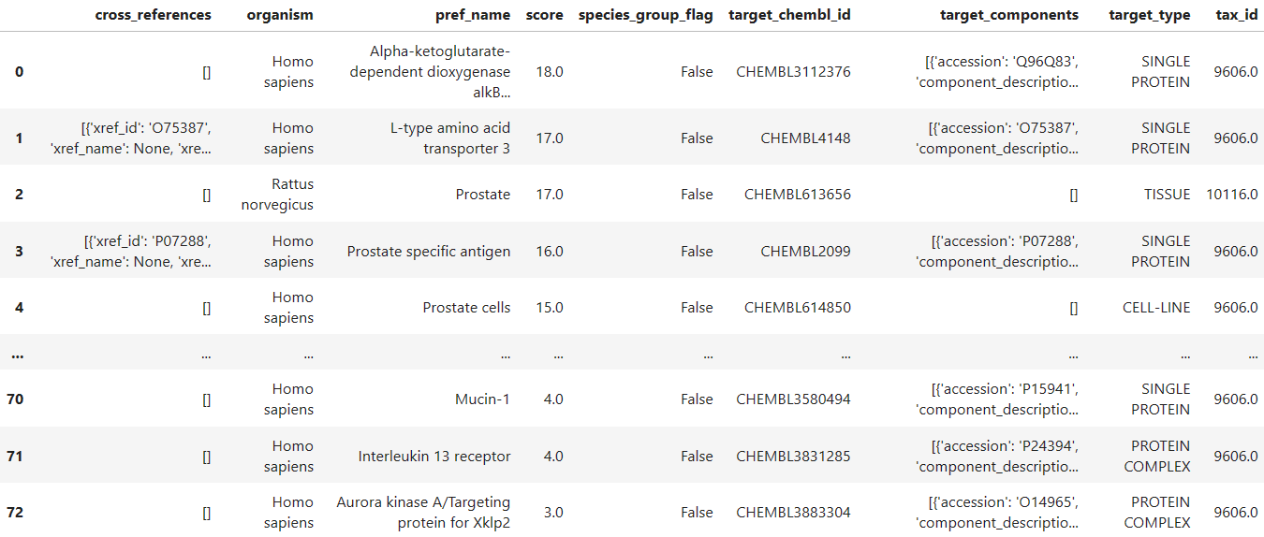
Dataset
ChEMBL Database is a database that contains curated bioactivity data of more than 2 million compounds. It is compiled from more than 76,000 documents, 1.2 million assays and the data spans 13,000 targets and 1,800 cells and 33,000 indications.

Slide 8




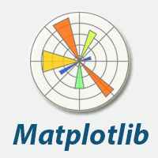

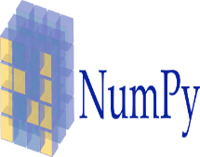

7. Technologies Used
Code Editor :
Pre-Trained models :
SGT Embedding
Elmo Encoder
Tape Embedding

Slide 9

8. Conclusion
Today’s large language models have reached a level of sophistication that enables them to effectively model the intricacies of molecular biology.
Our study highlights the importance of DTA prediction in drug discovery and screening.
Utilizing deep learning, our model combines molecule and protein embeddings, resulting in enhanced predictive accuracy.-
Comparative analysis reveals our model outperforms existing methods, showcasing its effectiveness.-
Beyond superior performance, our model offers a novel strategy for deep learning-based virtual screening, advancing drug discovery technologies.

Slide 10
9. References
For an Article in a Journal :
[1] Liu, Jiajia, Mengyuan Yang, Yankai Yu, Haixia Xu, Kang Li, and Xiaobo Zhou. "Large language models in bioinformatics: applications and perspectives." arXiv preprint arXiv:2401.04155 (2024).
[2] Xia, Leiming, Lei Xu, Shourun Pan, Dongjiang Niu, Beiyi Zhang, and Zhen Li. "Drug-target binding affinity prediction using message passing neural network and self supervised learning." BMC genomics 24, no. 1 (2023): 557.
[3] Qizhi Pei, Lijun Wu, Jinhua Zhu, Yingce Xia, Shufang Xie, Tao Qin, Haiguang Liu, Tie-Yan Liu, Rui Yan, Breaking the barriers of data scarcity in drug–target affinity prediction, Briefings in Bioinformatics, Volume 24, Issue 6, November 2023, bbad386, https://doi.org/10.1093/bib/bbad386
[4] Jiang, M., Wang, S., Zhang, S. et al. Sequence-based drug-target affinity prediction using weighted graph neural networks. BMC Genomics 23, 449 (2022). https://doi.org/10.1186/s12864-022-08648-9
Links :
https://www.ncbi.nlm.nih.gov/pmc/articles/PMC10802675

Slide 11
Thank You..

